Slide 1
Android Development
Android Studio, Activities & Fragments

Slide 2
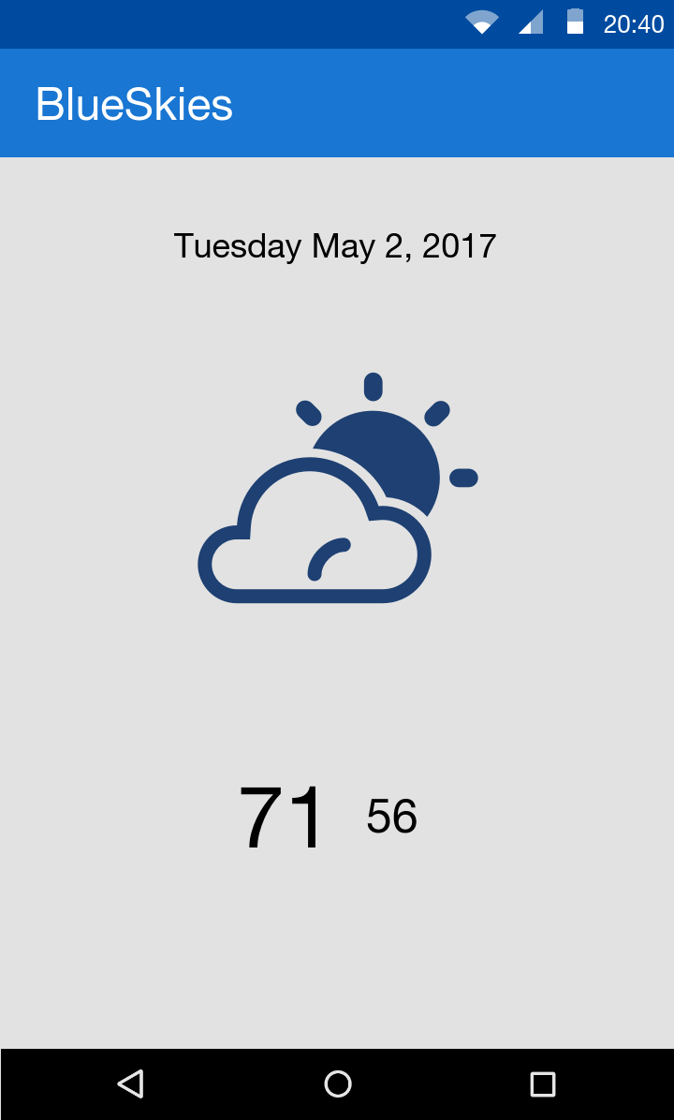
Goals
Develop a BlueSkies App

Slide 3
Agenda
High Level
Android Studio
Overview
Activity
Responsibility
Caveats
Fragment
Responsibility
Caveats

Slide 4
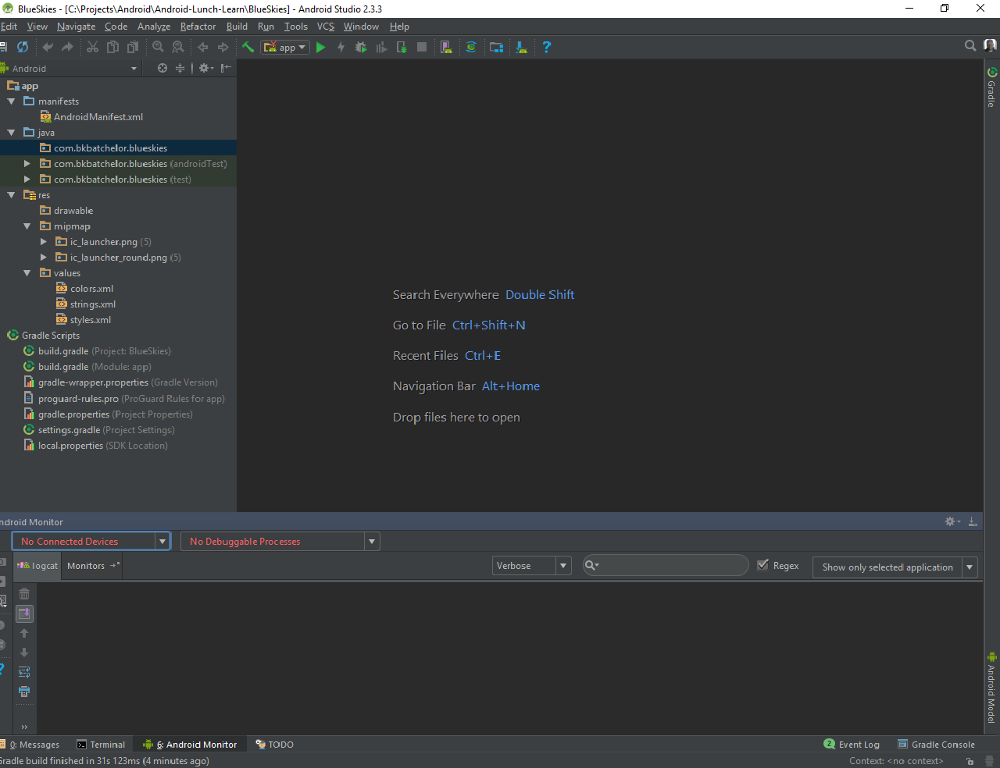
Android Studio
De facto standard for Android development
Built on the IntelliJ
Some features
Layout Editor
Built in emulator
Gradle integration
Instant Run (Hot swap)
https://developer.android.com/studio/index.html

Slide 5
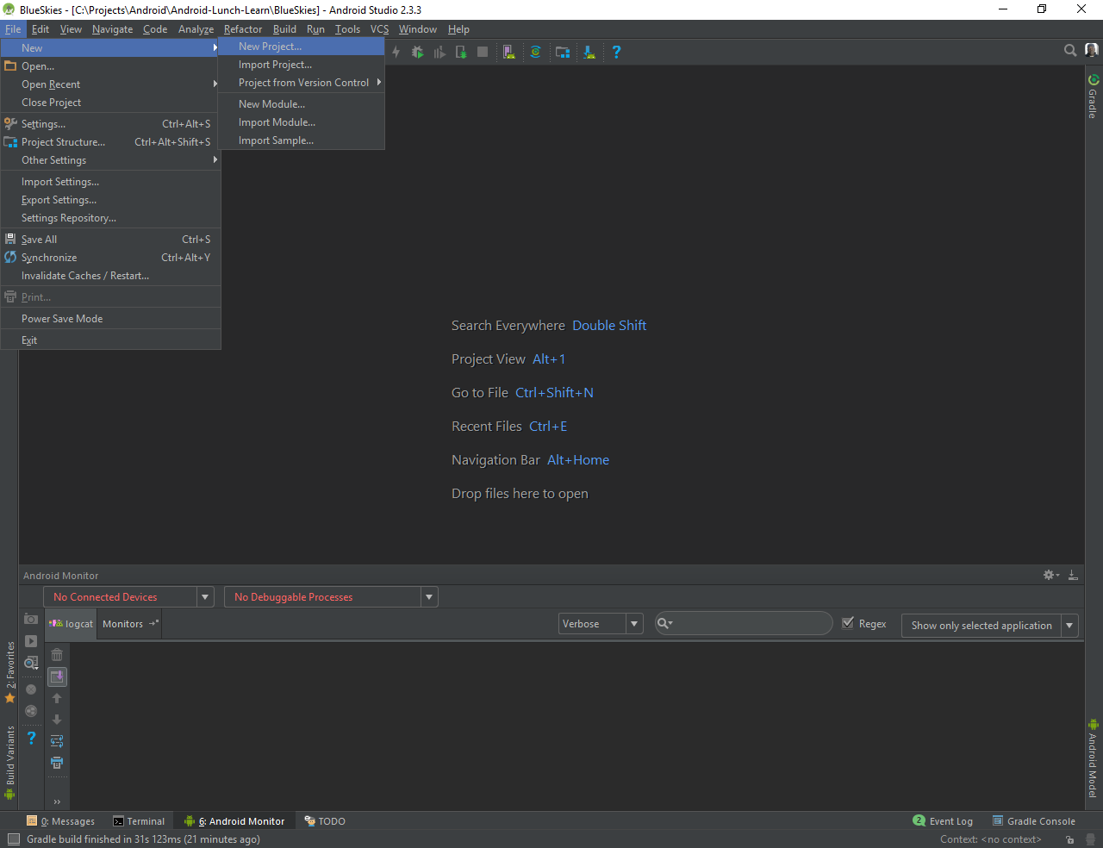
New Project

Slide 6
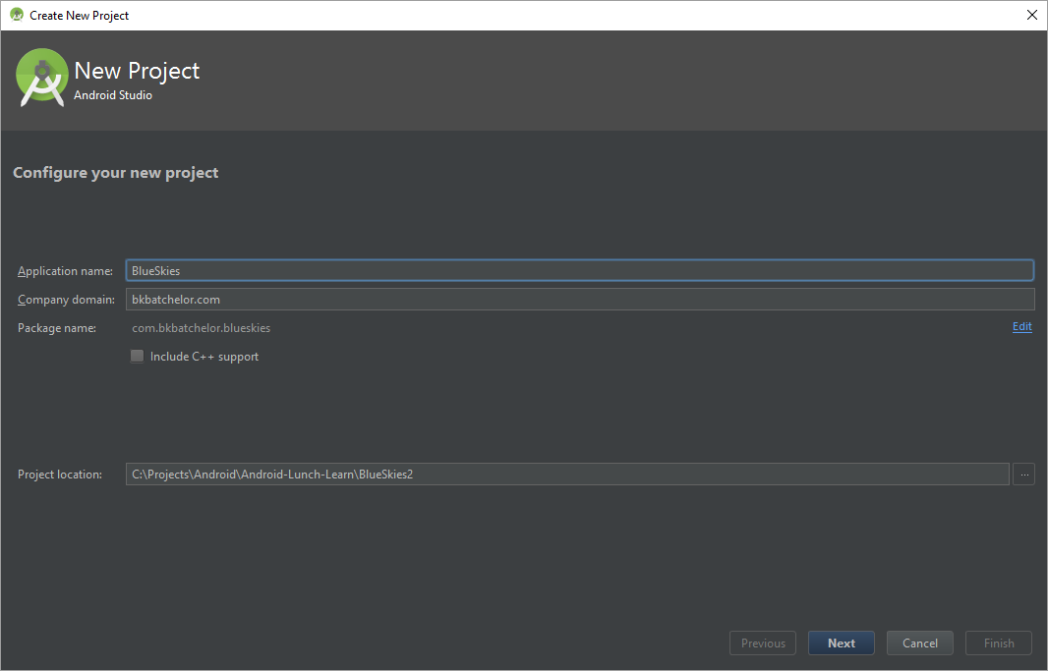
New Project (cont)

Slide 7
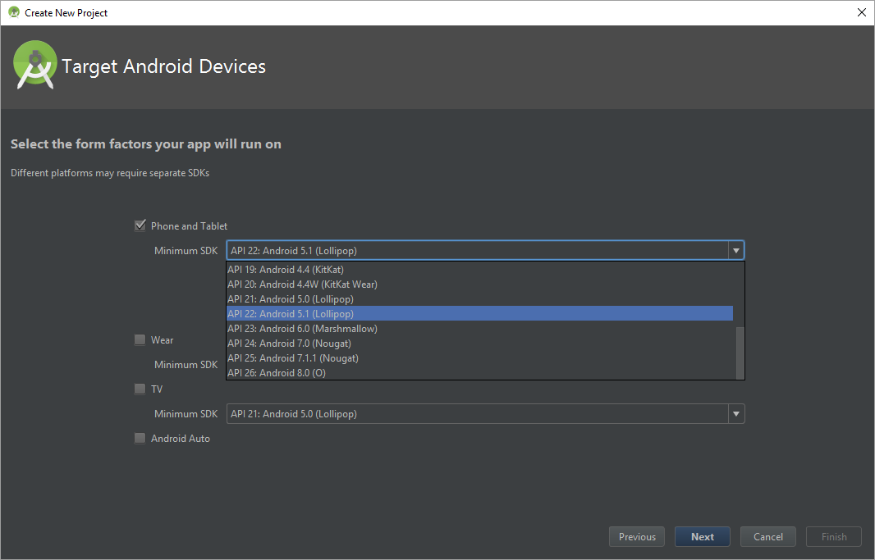
New Project (cont)

Slide 8
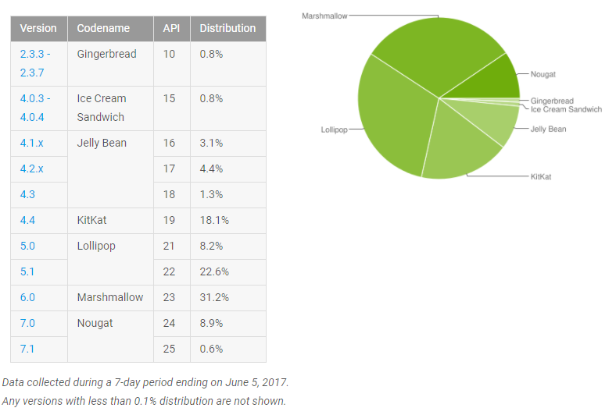
Android Versions

Slide 9
Example Android Developer References

Slide 10
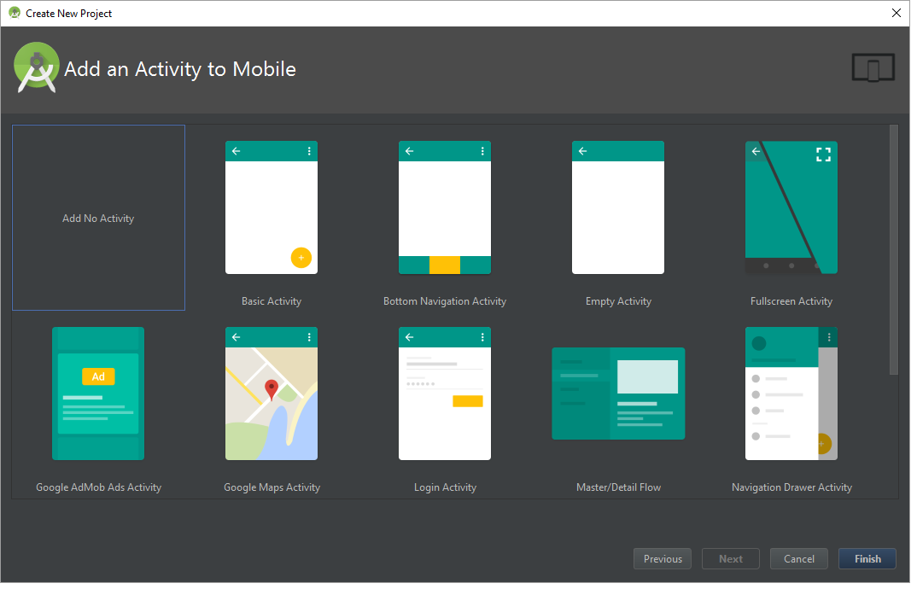
Add Activity

Slide 12
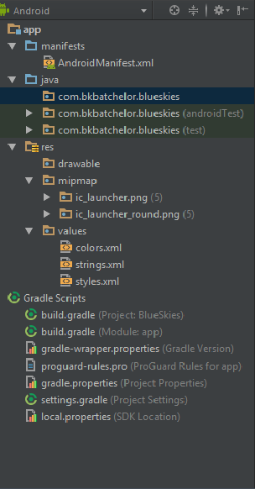

Project Pane

Slide 13
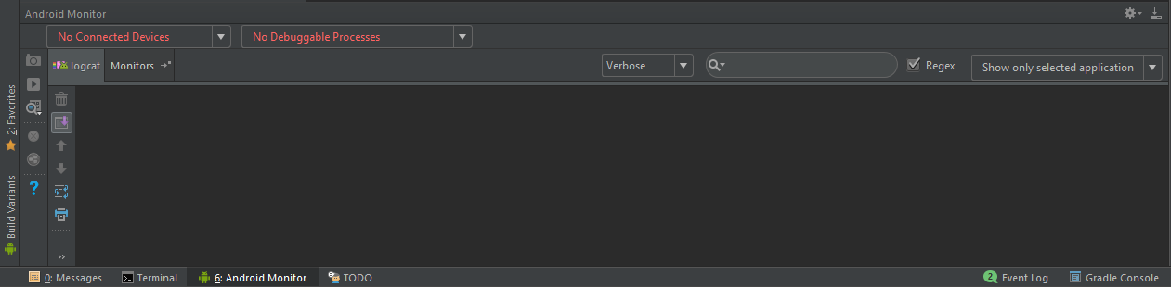
Monitoring and Logcat pane

Slide 14

Run and Debug

Slide 15
Activity

Slide 16

Activity https://developer.android.com/guide/components/activities/index.html
Fundamental building blocks
Entry point for user's interaction
Provides navigates within an app
Communication between other activities
Communication between child fragments
No Creation or Modification of Views

Slide 17
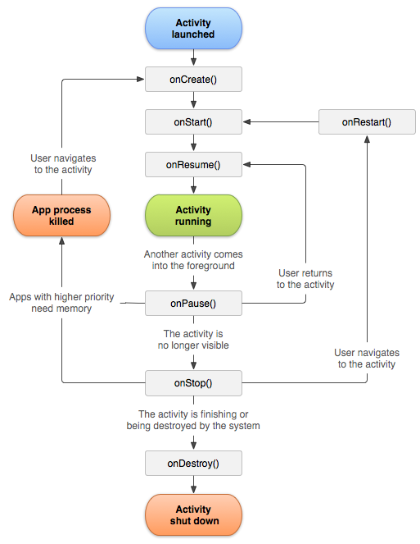
Activity Lifecycle
onCreate() started, but not visible
onStart() visible, but not ready for interaction
onResume() moved to the foreground and ready for interaction
onPause() moving to the background and stopping user interaction
onStop() moved to the background and not visible
onDestroy() moved to the background, not visible and flagged to be destroyed by the system

Slide 18

Lifecycle relationships
onCreate
onDestroy
Initialize variable
onStart
onStop
Register components (i.e. broadcast receivers)
Unregister components
onResume
onPause
Remove listeners
Set listeners (i.e. click or change)
Save data (i.e. database)

Slide 19
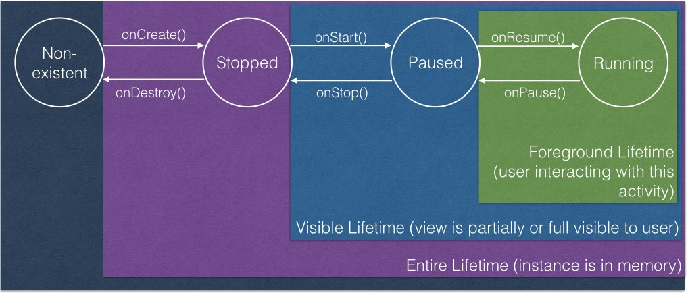
Activity’s States
Kristin Marsicano
Fragmented Podcast: Episode 76 (Taming the activity lifecycle)

Slide 20
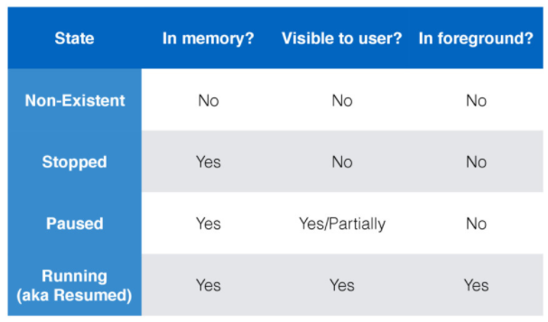
Activity’s States
Kristin Marsicano

Slide 21
Create MainActivity
Best Practices
Keep lifecycle methods in order
Place other methods (helpers) below the lifecycle methods

Slide 22
Fragment
View and Layout logic
Event handling (i.e. onClick())
Network request
Interacting with a persistence storage

Slide 23
Detail Level

Slide 24
Activity Lifecycle counterparts
OnCreate()
OnDestroy()
onStart()
onStop()
onResume()
onPause()

Slide 25
Activity Lifecycle
onRestart() activity is stoppd, then started again

Slide 26
Hitting back
onDestroy()

Slide 27
Home button
Stopped

Slide 28
SavedInstanceState
On Rotation
App is killed

Slide 29
Github

